Slide 1

LD7092 Principles of Software Engineering
Session 03
Requirements Formalizing

Slide 2

Aims
Requirements Documentation Techniques
Use case modelling
House Style Documentation

Slide 3

Diagram vs Model
Model is a description of any aspect of a software system.
A Model element is a building block of a software model.
A Diagram is a visual geometric symbolic representation of a software model.
A software model can be represented in one or more diagrams with different aspects.

Slide 4
Activity Diagrams

Slide 5
Sequence Diagrams

Slide 6
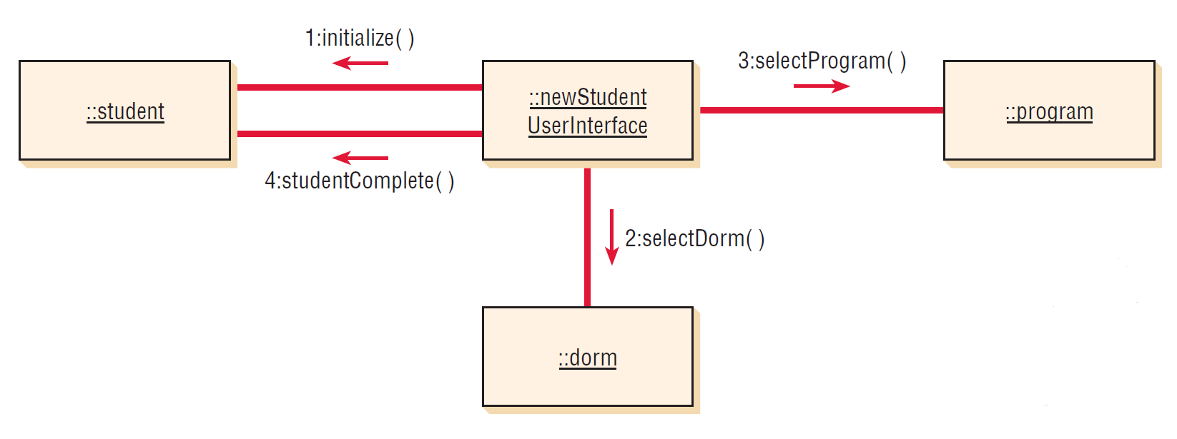
Communication Diagrams

Slide 7
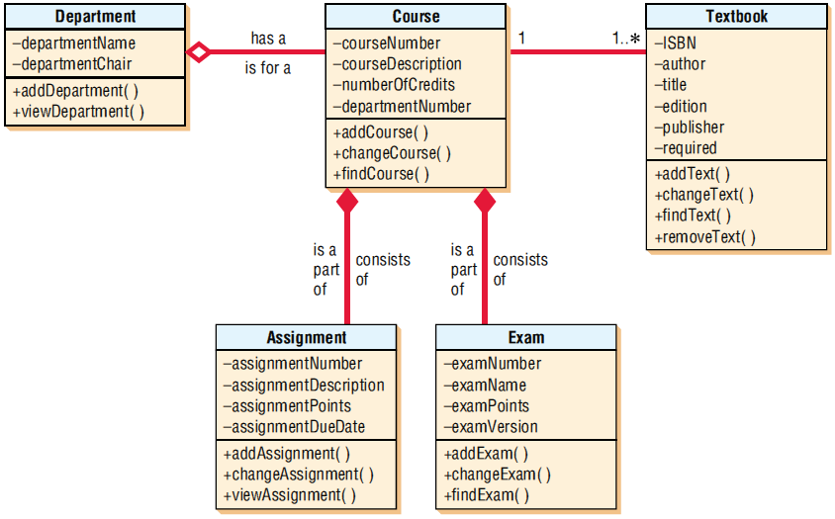
Class Diagrams

Slide 8
Software Requirements Documentation
purpose
features
criteria
timeline

Slide 9
Requirements Documentation Techniques
Declarative requirements document
Use cases modelling
Data Models
Process Models

Slide 10
The Unified Modeling Language (UML)
UML is a standard visual modeling language
UML can be applied to diverse application domains
UML is not a software development process
provides guidance as to the order of a team’s activities
specifies what artifacts should be developed
directs the tasks of individual developers
current version of the Unified Modeling Language™ is UML 2.5

Slide 11
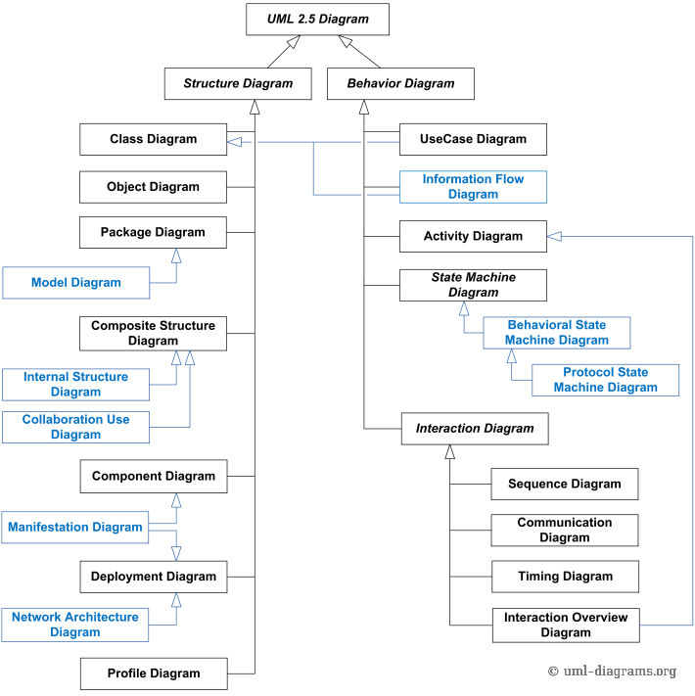

Slide 12
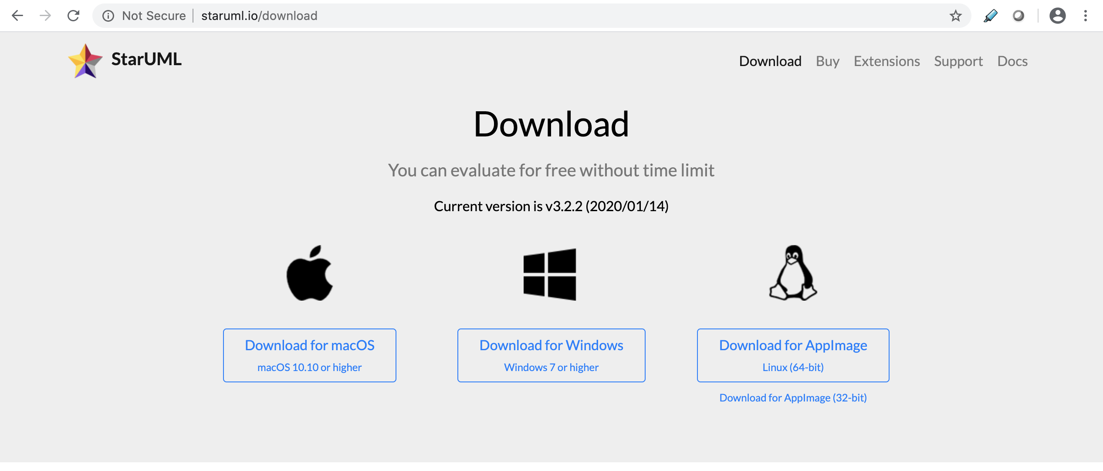
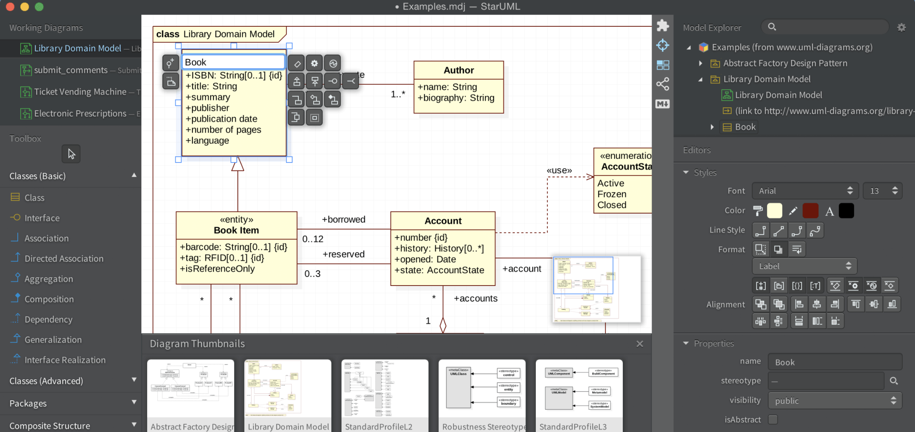
UML Diagrams Tools – starUML

Slide 13
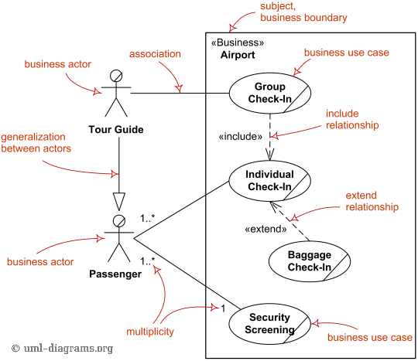
UML Business Use Case Diagram

Slide 14
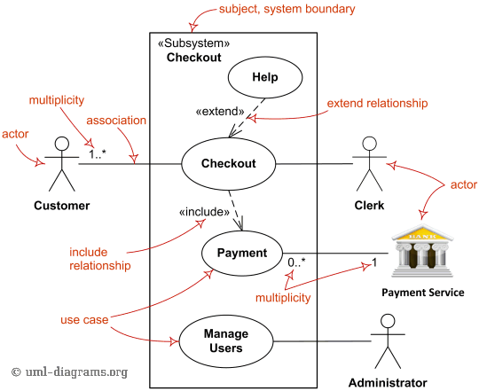
UML System Use Case Diagram

Slide 15
Use Cases
User
System
Functions

Slide 16
Focus of Use Cases
Actor’s point of view
Yield a result of value for the actor
Support tasks in business processes

Slide 17

Finding actors and use cases
Actors
Human
Non-Human
Use case
Function

Slide 18
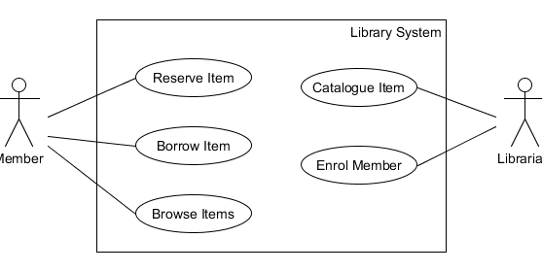
Use Case Diagram Example
Member
Librarian

Slide 19
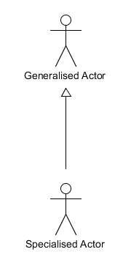
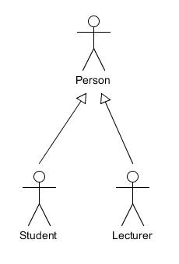
Actor Generalisations

Slide 20
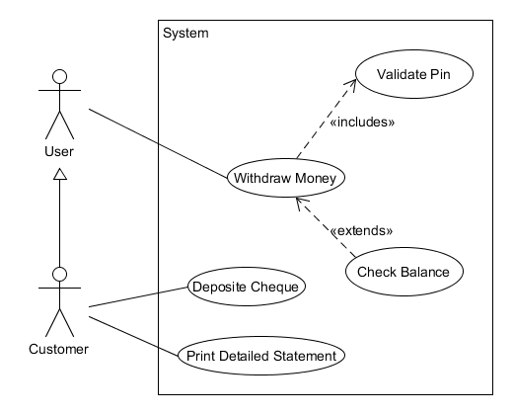
Use case relationship
<<includes>> one use case always involves another
<<extends>> under certain conditions, a use case follows a variant

Slide 21
About
Use Cases
Easy to create and read
Capturing different actors' views of the system
Developers to think from the user's perspective
BUT…
Does not capture non-functional requirements

Slide 22

Use case modelling
Step 1: Identify Actors and Use Cases
Step 2: Construct Use Case Model
Step 3: Use Case sequence of actions
Step 4: Identify use case dependencies and extensions
<<includes>>
<<extends>>
Generalization/specialization

Slide 23
Documenting a Use Case – Use case description
Name
Borrow Item
Goal
To create a loan record for each item borrowed.
Brief Description
A member brings the item, or items, to be borrowed to the checkout counter. The member selects the borrow items option and provides membership identification. The member then identifies which item(s) are being borrowed. The library system makes a loan record for each item lent and the member takes the item(s).

Slide 24
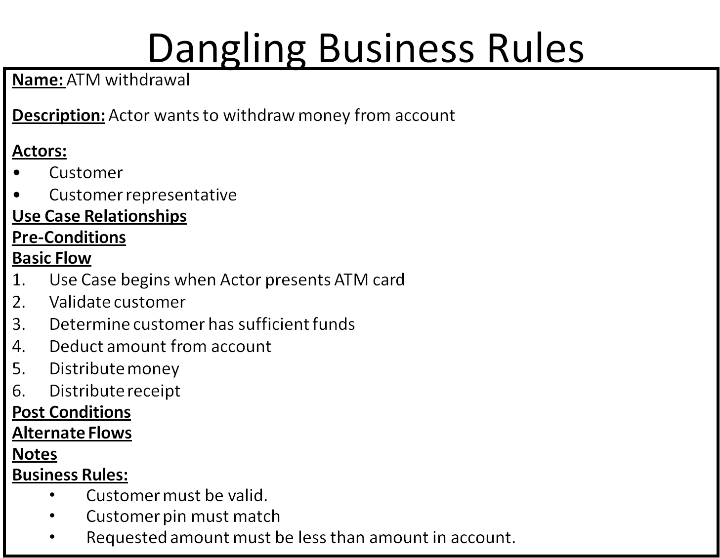
Use Case Template (House Style)

Slide 25
Seminar
Read relevant documents available in related session on Blackboard, work on the case study

Slide 26
What we covered
Requirements Engineering
requirements documentation techniques
Use case modelling
House style documentation

